Slide 1
BioLUC Model Development
Steve Peterson
Biofuels Land Use Change Modeling Workshop
Oak Ridge National Laboratory
May 8th, 2013

Slide 2
Purpose and Overview
Introduce you to key structures in BioLUC model
Identify “challenges” associated with model development effort

Slide 3
Protective vs Reflective Models
Protective Model | Reflective Model
Prove a point | Promote inquiry
Obscure assumptions | Expose hidden assumptions
“Cherry pick” data | Identify data weaknesses
“Prove” preconceptions and preselected answers, while covering biases | Challenge beliefs while support multiple perspectives and involving a broad community of interests
Promote the authority of the modeler | Promote the empowerment of clients
Adapted/revised from Sterman, 2000, from Isaacs and Senge, 1992

Slide 4
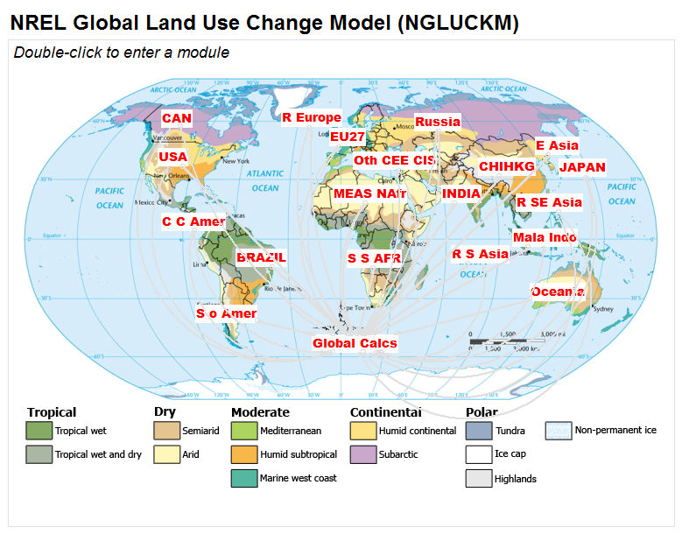
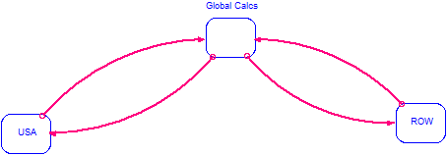
Modular, Regional Approach
Simple!
Not-So-Simple!

Slide 5
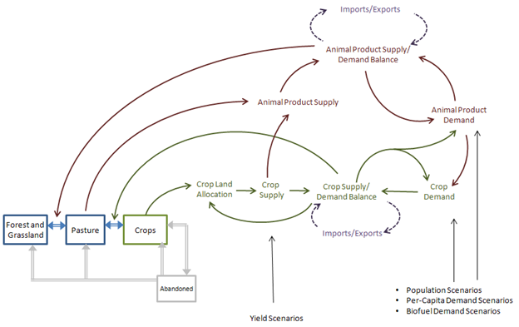
Essential structure within each region
Figure 1 from Modeling biofuel expansion effects on land use change dynamics
Ethan Warner et al 2013 Environ. Res. Lett. 8 015003 doi:10.1088/1748-9326/8/1/015003

Slide 6
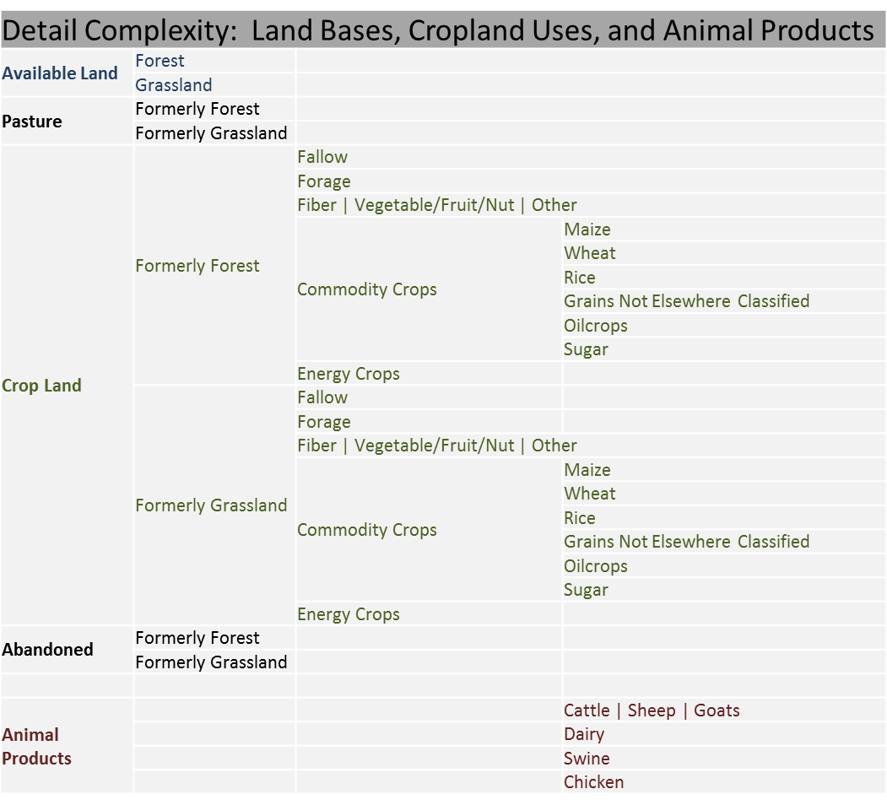
Dimensionality/Detail complexity

Slide 7
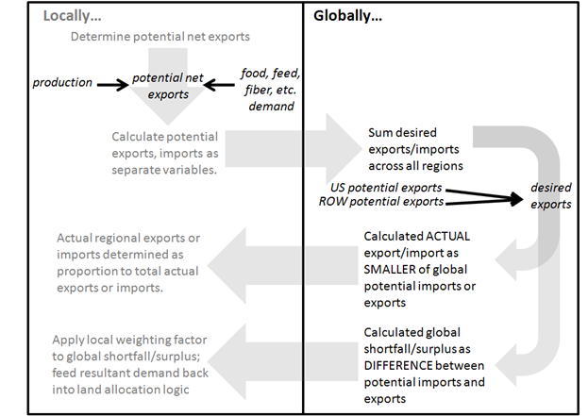
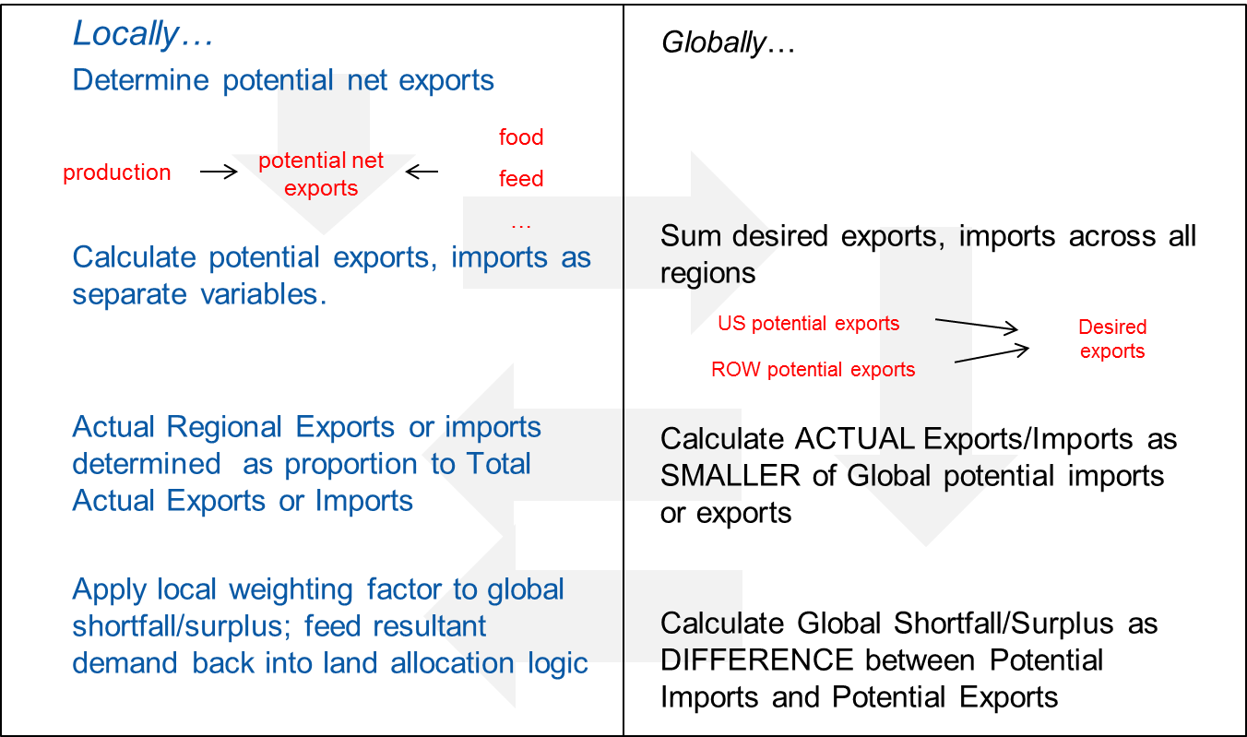
Flows between regions

Slide 8
Challenges
Detail complexity resulting from multiple region structure of model
Uncertainty around data
Calibration
International Trade
Region-specific, animal-product-induced demand for commodities, forage, pasture

Slide 9
Detail complexity
Multiple regions imply multiple opportunities to introduce error!
Disproportionately difficult to define and execute scenarios; develop useful output metrics and visualizations.
Simple!
Not-So-Simple!

Slide 10
Data uncertainty
Data for US is pretty good, but data for other regions can be a bit less certain
Forage land → significant component of land base, but forage yield difficult to estimate with high degree of certainty
Pasture land → VERY significant component of land base, but pasture yield VERY difficult to estimate with high degree of certainty. Current yield formulation pegged to forage yield, but requires calibration factor.
Interaction with animal product logic compounds difficulties

Slide 11
Calibration
Stock/flow structure of model requires internal consistency in data around demand, yields, land allocation
Potential issues in pasture yield, forage yield, and animal product demand for commodities, forage pasture required introduction of “calibration factors”
Modifications to animal product demands for commodities, forage demand, pasture yield

Slide 12
International Trade
Structure around international flows of commodity products, animal products is less transparent than desirable
Lack of market mechanism may lead to criticism of model
Good news: initial vetting of trade structure suggests that it works pretty well!
Key parameter: region-specific, product-specific “responsiveness to global shortfall”

Slide 13
Demands driven by animal products
Current structure not satisfactory—requires substantial calibration factor
Potentially better structure:
Define “completely intensive” animal product crosswalk
Define “completely extensive forage driven” animal product crosswalk
Define “completely extensive pasture driven” animal product crosswalk.
Within each region, set crosswalk as weighted average
Intensive vs extensive; forage vs pasture
Weighting factors could be static or set as scenarios.

Slide 14
Discussion

